Slide 1


Online Food Ordering and Delivery Management System
A MySQL-based Relational Database Project
Presented by
MD. All Shahariar Shakib(0112330360)
Sadeed S’aad Zaman Shefin(0112330362)

Slide 2


Objective of the Project
🎯 🎯 🎯 🎯 Goal 🎯 🎯 🎯 🎯
•Streamline Ordering: Enable customers to browse menus, add items to cart, and place orders online with ease.
•Manage Users & Accounts: Provide secure login, profile management, and saved delivery addresses.
•Efficient Order Processing: Track orders, calculate payments, and manage order status from placement to delivery.
•Delivery & Rider Management: Assign riders, track their progress, and ensure timely deliveries.
•Admin Control: Allow administrators to manage menus, monitor orders, and oversee overall system operations.

Slide 3

Problem Statement
• Traditional Food Ordering is Inefficient
• Order Mismanagement
• Delivery Challenges
• Inventory Issues
• Lack of Centralized Control

Slide 4


Scope of the Project
👤 Customer Module
🏪 Admin Module
🚴 Rider Module
📦 Order & Inventory Management
💬 Communication & Support

Slide 5
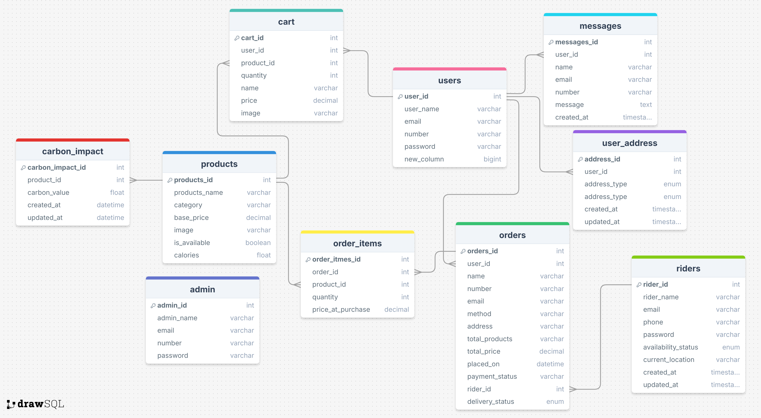
ER Diagram

Slide 6

Database Schema Overview
admin → id, name, password
users → id, name, email, number, password, address
user_addresses → id, user_id, address_type, address_text, created_at
products → id, name, category, price, image, calories
carbon_impact → id, product_id, carbon_value, created_at
riders → id, name, email, phone, password, status, current_location, created_at
orders → id, user_id, name, number, email, method, address, total_products, total_price, placed_on, payment_status, rider_id, delivery_status
order_items → id, order_id, product_id, quantity, price_at_purchase
cart → id, user_id, product_id, name, price, quantity, image
messages → id, user_id, name, email, number, message, created_at

Slide 7


Features Implemented
• User Management
• Food Menu Browsing
• Cart & Ordering System
• Payment Integration
• Order Tracking
• Delivery/Rider Management
• Inventory Management
• Admin Dashboard
• Communication System
• Reports & Analytics

Slide 8


Future Enhancements
• AI-based Recommendations for Users
• GPS-enabled Live Tracking for Deliveries
• Push Notifications & SMS Alerts
• Rewards, Offers, Loyalty Points
• Voice & Chatbot Ordering
• Advanced Analytics & Business Insights
• Multi-Language & Multi-Currency Support

Slide 9

Contact Us
MD. All Shahariar Shakib
Sadeed S’aad Zaman Shefin
Email
Phone
mshakib2330360 @bscse.uiu.ac.bd
sshefin2330362@bscse.uiu.ac.bd
01521786893
01303359880
Thank You

